Slide 1
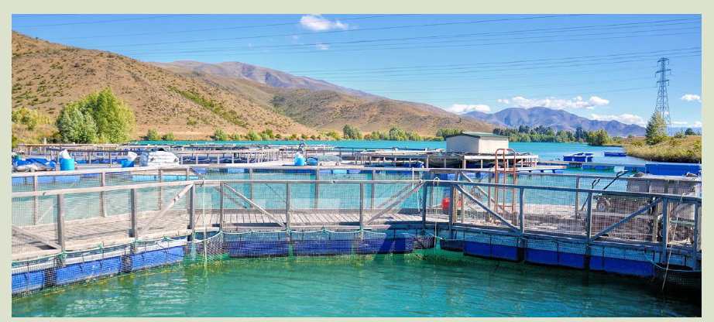

AQUACULTURE BIOSECURITY
Joseph Mphande
MSc Sustainable Aquaculture –University of Stirling, UK
MSc -Aquaculture and Fisheries Science-LUANAR, Malawi.
Email: josephmphande90@gmail.com

Slide 2
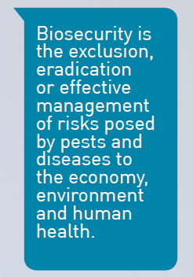
INTRODUCTION
WHAT IS BIOSECURITY?
The term biosecurity first referred to biological weapons and bio-terrorism.
Originally used in reference to the management of biological weapons and bio-terrorism, the term biosecurity was first used in the agricultural sector in the 1980s as “the sum of risk management practices in the defence against biological threats”

Slide 3
INTRODUCTION
WHAT IS BIOSECURITY?
Defined as “a set of management and physical measures designed to mitigate the risk of introduction of pathogenic agents into, or spread within, or release from, aquatic animal production”.

Slide 4
INTRODUCTION
WHAT IS BIOSECURITY?
It is now used in diverse sectors including biological laboratory risks and infectious disease prevention in both animal and public health.
Health management in the aquaculture sector must be applied and addressed for sustainability purposes.

Slide 5
INTRODUCTION
The definition of the biosecurity concept by the Food and Agriculture Organization (FAO) is a strategic and integrated approach that encompasses the policy and regulatory frameworks for analyzing and managing relevant risks to human, animal, and plant life and health and the environment (FAO 2007, 2020).
The concept is applied to production sectors like; Agriculture, poultry, animal husbandry, and aquaculture industries, which need proper health management of their production system.

Slide 6
INTRODUCTION
The rapid growth of the global aquaculture industry has led to a dramatic increase in the spread of pathogens (e.g., pests, bacteria, viruses, and other parasites) by translocation of commercial aquatic organisms, such as fishes, shrimp, and mollusks
These pathogens causes economic loss, reduction in profit and revenues and poor food security systems, low market accessibility.
Preventing and controlling pathogen spread is a major concern of aquaculture biosecurity starting from on-farm to national and international levels, particularly when unrecognized species enter transport pathways.
As “prevention is better than cure,” it is advisable to focus on preventing the occurrence of pathogens in the aquaculture system.

Slide 7
PROTECT YOUR FARM IN SEVEN STEPS
1.Maintain stock health and welfare
Follow good animal husbandry practices.
The benefits of good animal welfare and biosecurity go hand-in-hand and should minimise animal stress where practicable.
2.Be aware of the pathways of risk organisms onto, within and off your farm
Make sure your staff are familiar with the pests and diseases of concern and their pathways.
Carry out biosecurity induction and ongoing training to explain required behaviours and hygiene practices on your farm.

Slide 8
PROTECT YOUR FARM IN SEVEN STEPS
3.Obtain pest and disease-free stock
Preferentially source stock from areas/facilities with a known health status and with a health monitoring programme.
Keep records of all stock movements onto, within and off your farm so they can be traced in the event of a problem.
4. Keep things clean
Carry out good cleaning practices to help prevent the introduction, exacerbation and spread of pests and diseases.
All people (including workers and visitors), equipment, vehicles and vessels represent potential ways of spreading pests or diseases onto, within or off your farm.

Slide 9
PROTECT YOUR FARM IN SEVEN STEPS
5.Check your farm
Constant vigilance is vital for early detection of pests and diseases.
Regularly monitor your stock for signs of unusual behaviour, colourations, pests or mortalities.
Knowing what is normal will help you to recognise what isn’t.
Keep records (written, photographic) of all unusual observations.

Slide 10
PROTECT YOUR FARM IN SEVEN STEPS
6.Report anything unusual
Farmers are regularly in and around the aquatic environment and therefore are well placed to notice anything out of the ordinary.
If your stock appears abnormal or experiences unusual sickness or mortalities.
7.Have a biosecurity management plan in place
A biosecurity management plan will help you to assess and prioritise the biosecurity risks relevant to your farming operation.
Implementing good biosecurity practices will in turn help you prevent, reduce or manage those risks.

Slide 11
MAJOR WAYS OF PATHOGEN TRANSMISSION
Aquaculture biosecurity can be effectively managed when there is an understating of pathways that can introduce, take away or reinfect the farm/stock (incoming, outgoing or enhancing the infection).
Examples of pathways include;
Stock movements and containment
Introduction of new stock or broodstock onto your farm.
Stock movements within your farm.
Stock movements off your farm.
Stock escapes.

Slide 12
MAJOR WAYS OF PATHOGEN TRANSMISSION
2. Water
Water that can be controlled -pumped or flowed onto, within and off your farm
Uncontrolled water – farms that reside in water e.g. in lakes
Water that stock is transported in.
3. Equipment
Nets, ropes, baskets, buoys, containers, clothing, footwear
Vessels – supply boats
Vehicles – transporting trucks, trailers, courier vans.

Slide 13
MAJOR WAYS OF PATHOGEN TRANSMISSION
4. People
Site staff
Staff from other farms
Visitors, contractors, couriers, suppliers.
5. Feed
Stock feed
Raw materials.
6. Wildlife
Marine mammals, birds
Vermin (rats, mice, stray or feral animals)
Domestic animals.

Slide 14
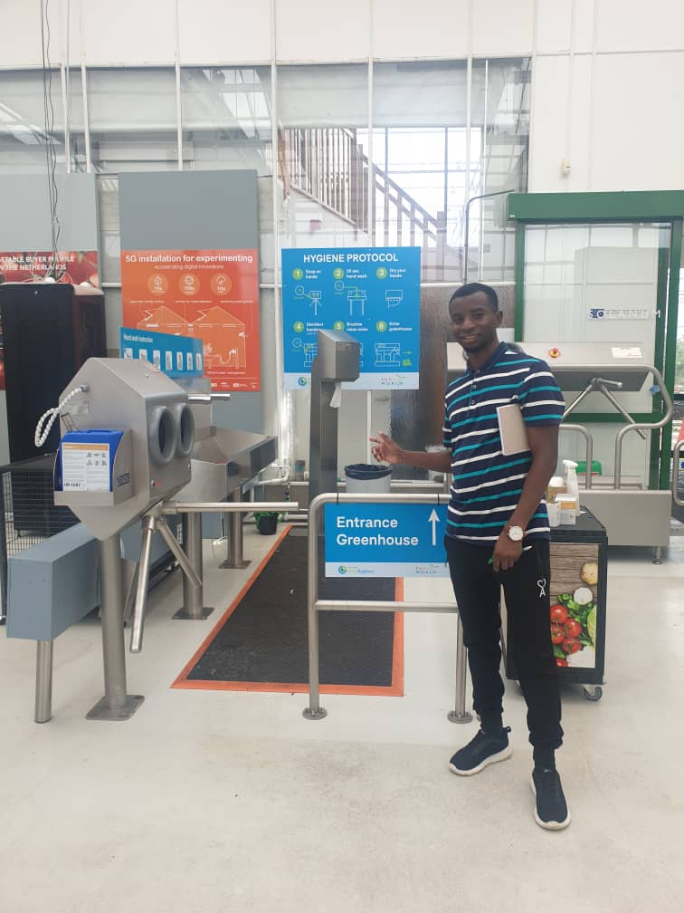
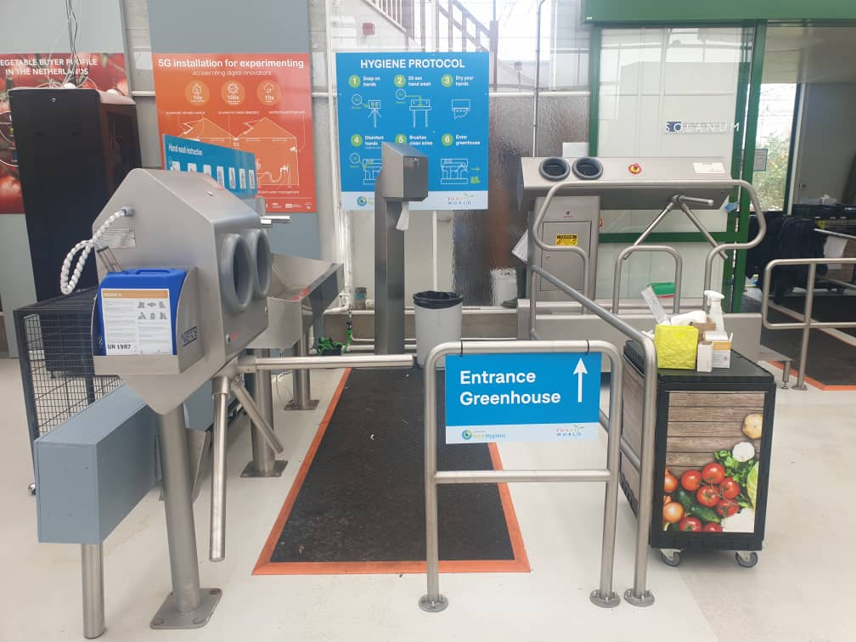
MAJOR WAYS OF PATHOGEN TRANSMISSION
.

Slide 15
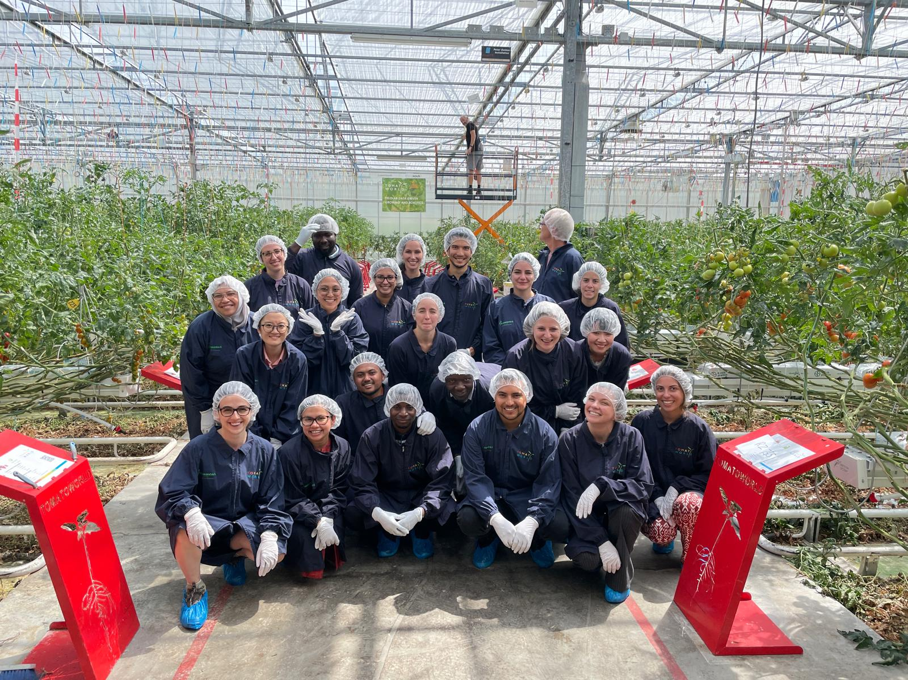
MAJOR WAYS OF PATHOGEN TRANSMISSION
.

Slide 16
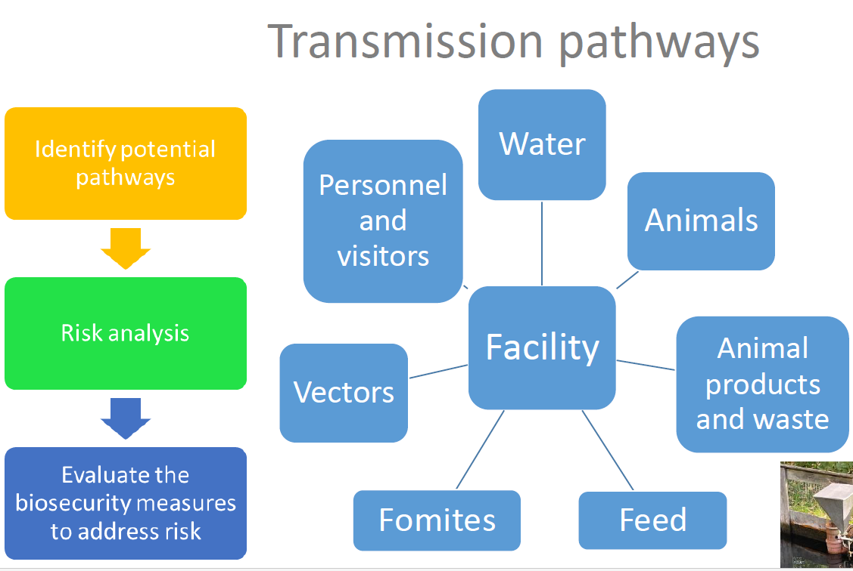
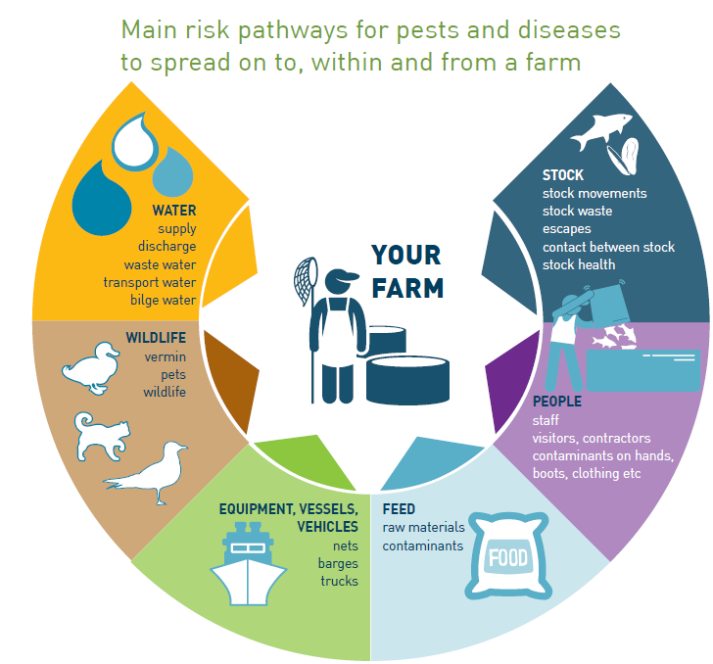
TRANSMISSION PATHWAYS

Slide 17
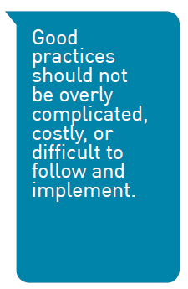
COMING UP WITH A BIOSECURITY PLAN
Developing a plan comes with having clearer biosecurity Management Objectives and simple practices.
The following are some of the farm biosecurity plans and practices which can be executed.

Slide 18
COMING UP WITH A BIOSECURITY PLAN
1. STOCK HEALTH MANAGEMENT
Objective: Stock health should be maintained to optimum levels.
Simple practices.
Keep stock stress to a minimum.
Maintain optimum water quality levels.
Maintain appropriate stocking densities.
Provide appropriate diets and nutrition.
Avoid unnecessary or rough handling of stock.
Keep transfers within or between farms to a minimum.
Monitor stock frequently.
Remove dead or dying stock from remaining stock as soon as practicable.
Monitor and keep records of all aspects of stock health management

Slide 19
COMING UP WITH A BIOSECURITY PLAN
2. STOCK MOVEMENTS AND CONTAINMENT
Objective: Minimise the pest and disease risk associated with stock movements onto, within and off your farm.
Simple practices
Only stock of known health status should be introduced onto your farm.
Only move stock off your farm to locations of equal or lesser health status than the current location.
Prevent stock escapes.
If stock of unknown health status is to be introduced (e.g. wild broodstock, seed stock), this stock should be isolated in separate production units or dedicated quarantine facilities (e.g. land-based farms)
Precautions should be undertaken to prevent the within farm spread of pests, disease until such situations are resolved
Keep accurate records of all stock movements onto, within or off your farm.

Slide 20
COMING UP WITH A BIOSECURITY PLAN
3. Water sources (land-based farms)
Objective: Minimise the risks of pests and disease entry and spread associated with incoming water.
Simple practices
The water supply should be assessed for biosecurity risk and appropriate action(s) taken
Locate water intake and outflow pipes to avoid cross-contamination.
Treat intake water to an acceptable level so as to minimise the risk of pests and diseases entering your farm (screening, filtration, ultra-violet light, ozone).
Install screens on intake pipes to prevent entry of undesirable organisms.
Maintain good water quality at all times

Slide 21
COMING UP WITH A BIOSECURITY PLAN
4. EQUIPMENT, VEHICLES AND VESSELS
Objective: Minimise the risk of equipment, vehicles and vessels introducing and spreading pests and diseases onto, within and off your farm.
Simple practices
Assess all equipment, vehicles and vessels entering the farm for biosecurity risk and ensure that risk is managed by taking appropriate action(s)
Farms should have dedicated and well-designed delivery and loading areas
Standard operating procedures and dedicated infrastructure should be in place for cleaning and disinfection of equipment, vehicles and vessels

Slide 22
COMING UP WITH A BIOSECURITY PLAN
5. PEOPLE MANAGEMENT: Staff and visitors
Objective: Minimise the risk of staff and visitors transferring pests and diseases onto, within and off your farm.
Simple practices
Assess all staff and visitor access to farms for biosecurity risk and ensure that risk is managed by taking appropriate action(s).
Refusal of entry should be considered for high risk visitors
Manage farm access (e.g. access controls and signage)
All visitors should be briefed regarding on-farm biosecurity
Restrict staff and visitor access to sensitive areas.
Keep records of all visitors to your farm and education and staff training

Slide 23
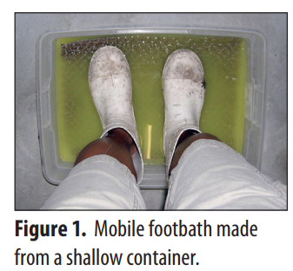
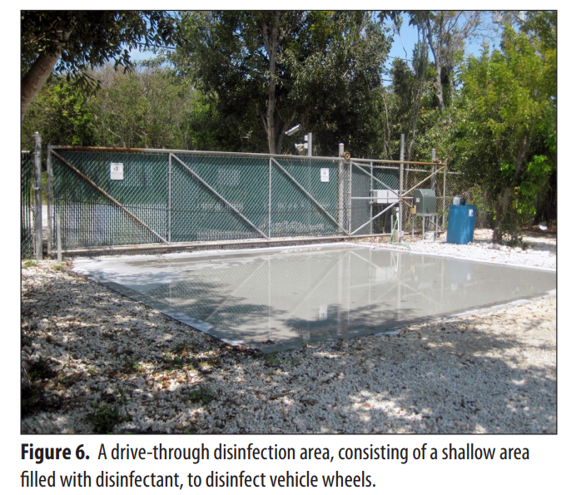
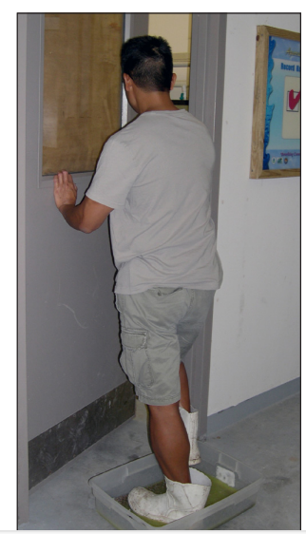
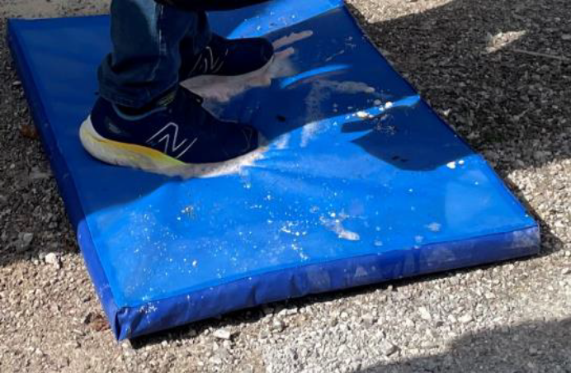
COMING UP WITH A BIOSECURITY PLAN

Slide 24
COMING UP WITH A BIOSECURITY PLAN
6. FEEDS AND FEEDING
Objective: Minimise the risk of feed exacerbating or transferring pests and diseases onto, within and off your farm.
Simple practices
All feeds entering the farm should be assessed for biosecurity risk and appropriate action(s) taken to address identified risk(s)
Source feeds from reputable suppliers to ensure they provide assurances of quality and content
Ensure any feed containing aquatic organisms is adequately treated to ensure safe product
Store feeds in designated areas (e.g. clean and dry) to avoid contamination and reduced feed quality
Regularly inspect feed to check for the presence of mould, vermin, and other undesirable organisms.

Slide 25
COMING UP WITH A BIOSECURITY PLAN
7. WILDLIFE, SCAVENGERS AND VERMIN
Objective: Minimise the risk of wildlife, scavengers, vermin, and pets transferring pests and disease onto, within or from the farm.
Simple practices
Control or exclude predators, wildlife, vermin and other organisms (e.g. aquatic life) from land-based systems
Control, exclude or prevent aggregations of predators, wildlife, vermin and other organisms (e.g. aquatic life) from open water systems
Regularly inspect farms for biosecurity breaches or signs of potential breaches and remedy as required
Keep records of any presence of wildlife and vermin, or biosecurity breaches and any preventive or corrective actions taken.

Slide 26
COMING UP WITH A BIOSECURITY PLAN
8.RECORD KEEPING
Objective: Record all information necessary to trace and determine the origin of pest or disease in the event of an outbreak.
Simple practices
Maintain records to trace stock, and their associated health status, onto, within or from the farm
Maintain records for all aspects of the biosecurity plan.
Other records that should be maintained include, but are not limited to:
all stock transfer on to, within, and off your farm
stock health, purchases and sales, monitoring and surveillance activities, testing and declarations, stocking densities, stock performance and feed schedules.

Slide 27
COMING UP WITH A BIOSECURITY PLAN
9.MONITORING/SURVEILLANCE
Objective: Minimise the biosecurity risk to a farm by implementing appropriate monitoring and surveillance practices.
Simple practices
Regularly inspect and monitor all of your stock and record abnormalities and mortalities (including early signs of stress, behavioural changes or presence of pests)
Investigate suspected health problems in your stock.
Observe and record abnormalities and mortalities in wild stocks around your farm.
Maintain access to qualified veterinarian or aquatic health professional who can provide advice and examine stock at short notice.

Slide 28
COMING UP WITH A BIOSECURITY PLAN
10. WASTE (OTHER THAN WATER)
Objective: Minimise the pest and disease risks associated with removal and disposal of farm waste.
Simple practices
All waste should be assessed for biosecurity risk to the farm and environment and appropriate action(s) taken to address identified risks
Containment, handling and disposal of waste should be conducted in a biosecure manner
Designate waste holding areas away from production or feed storage areas
Contain, handle and dispose of waste in a biosecure manner
Disposal of waste should be to an approved waste site or waste management company.

Slide 29
COMING UP WITH A BIOSECURITY PLAN
11. AUDITING
Objective: To ensure your farm biosecurity plan continues to address biosecurity risks effectively and efficiently.
Simple practices
Have audits conducted of on-farm biosecurity plans and their implementation at regular prescribed intervals
Farms should have a veterinary health plan (VHP), which includes a biosecurity plan that sets out biosecurity protocols, preventive measures, treatments and contingencies.
Your farm biosecurity plan should include a schedule for routine review and identify any triggers for extraordinary review.

Slide 30
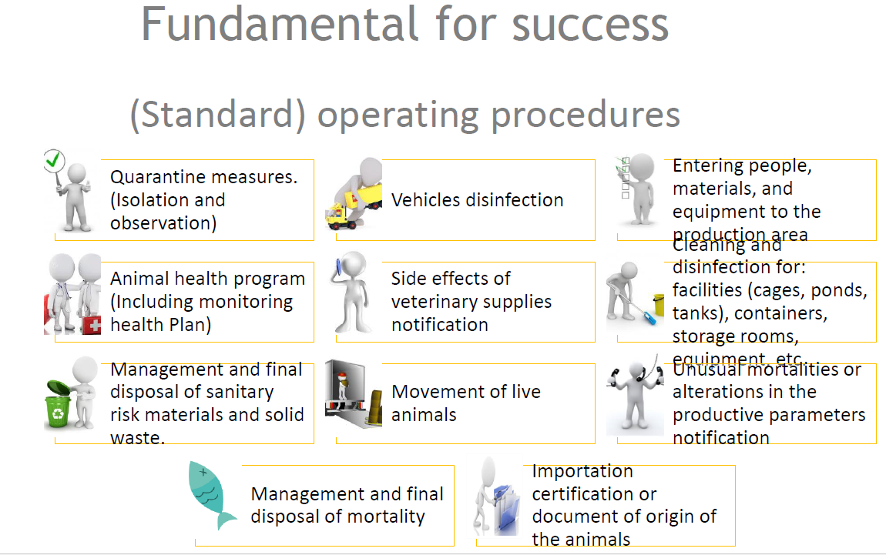

Slide 31
SOME BENEFITS OF BIOSECURITY
Improve market access
Increase productivity
Reduction in production costs
Reduction rate of emergence antimicrobial resistance
enhances food safety, protects the investments by preventing economic losses
optimizing the health and immunity of fish stocks

Slide 32
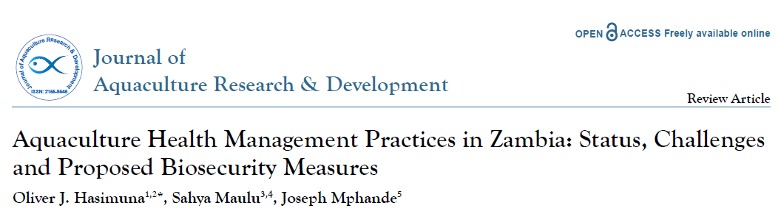
AQUACULTURE BIOSECURITY IN ZAMBIA
CHALLENGES
Lack of knowledge due to inadequate extension services
Poor entry and exit control measures against fish and other organisms
Lack of basic biosecurity measures
Lack of proper diagnostic tools
PROPOSED BIOSECURITY MEASURES
There is need to manage animals, people, vehicles and other moving equipment, water and sediments, feed, and solid and liquid wastes

Slide 33
CONCLUSION
Good biosecurity measures will reduce the risk of catastrophic losses from infectious disease and low-level losses that, over time, can also greatly affect the bottom line.
Work with an experienced aquatic animal health professional, production specialist, and aquacultural engineer to develop a comprehensive biosecurity plan.
Know your fish source and water source to ensure that specific pathogens don’t enter your facility by either route.
Quarantine, test, and continue to monitor fish health throughout the production cycle.
Good husbandry is key to reducing disease susceptibility

Slide 34
CONCLUSION
Regularly monitor systems, water quality, and fish. Isolate sick fish and remove dead and moribund fish.
Know which diagnostics to use and which treatments are legal and available.
Educate your personnel and visitors so that they understand and follow biosecurity protocols. Regularly evaluate educational programs.
Plan your facility’s sanitation, disinfection, and system management schemes and design your biosecurity with science, efficiency, and personnel compliance in mind.
Keep good records. Compliance with, and documentation of, biosecurity protocols will help reduce losses during an outbreak and may help prevent mandatory depopulation.

Slide 35
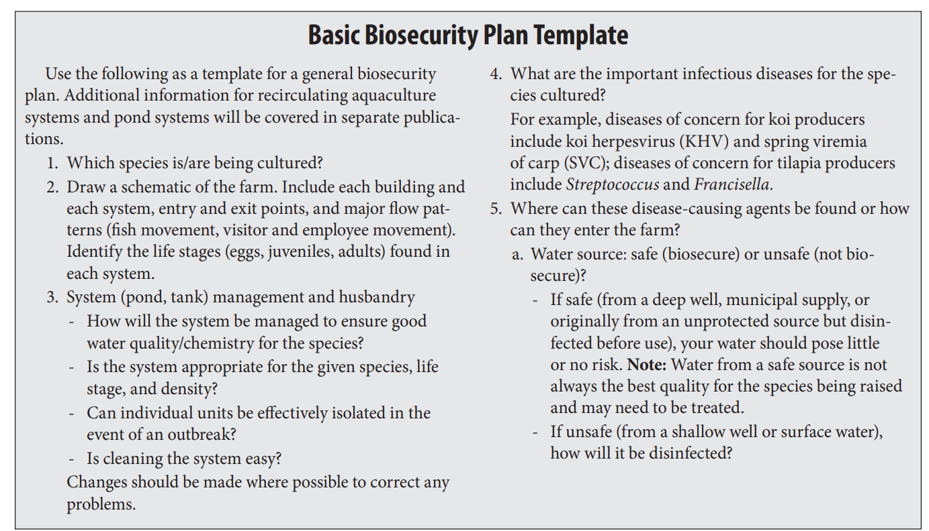
EXAMPLE OF PLAN

Slide 36
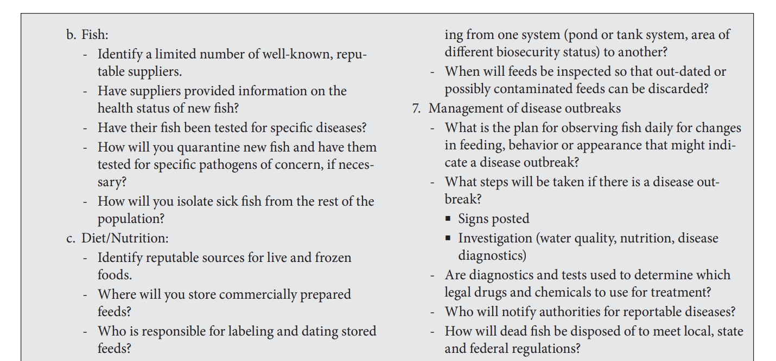
EXAMPLE OF PLAN

Slide 37
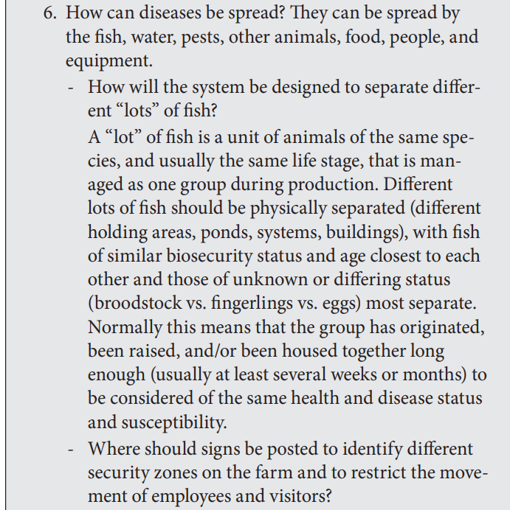
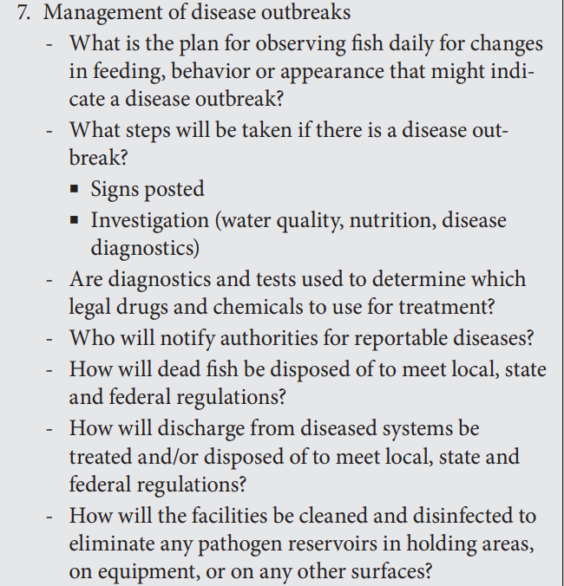
EXAMPLE OF PLAN

Slide 38
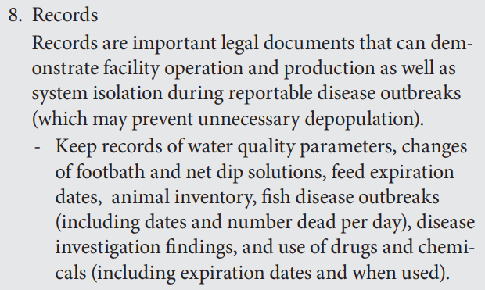
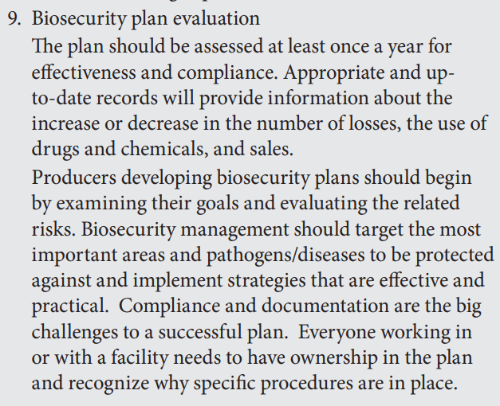
EXAMPLE OF PLAN

